Slide 1
WEKA
A library for Machine Learning

Slide 2

Self learning, then machine learning
Decision Tree (ID3)
Naïve Bayes
K Nearest Neighbor
Neural Network

Slide 3
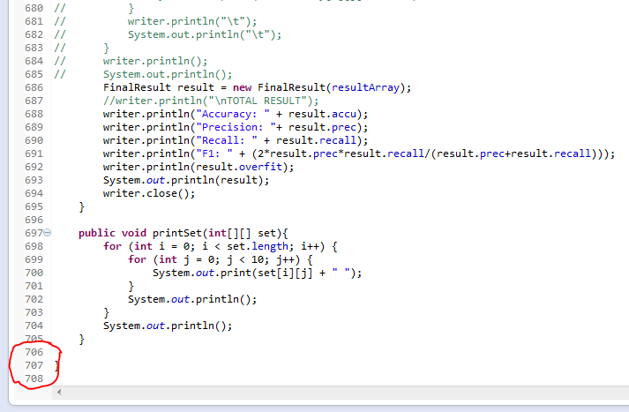
Manual Approach…
Advantages:
Flexible
Can be optimized manually
Can be easily modified
Disadvantages:
Too much coding
Too many bugs to solve
Optimization is hard to achieved
Other easy means are available

Slide 4

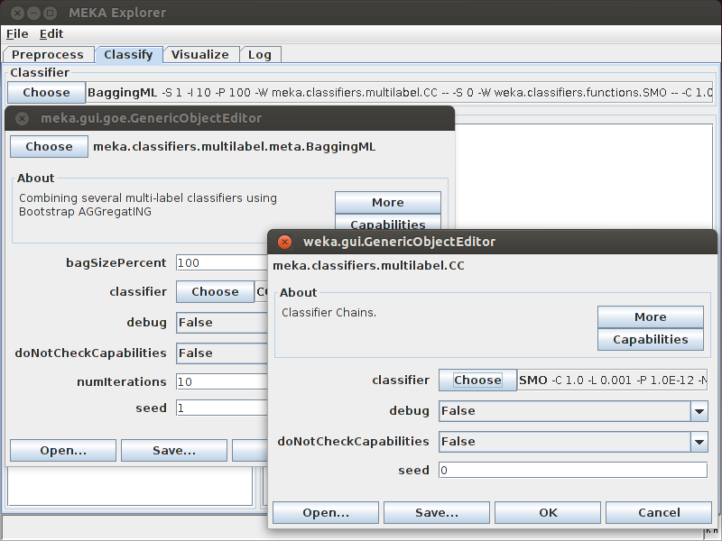
Introducing WEKA…
Java Library File
Graphical Window

Slide 5
Why Weka…
Highly Optimized
Easy to use
All we need to do is to change the input data accordingly
All the statistics are easy to calculate

Slide 6
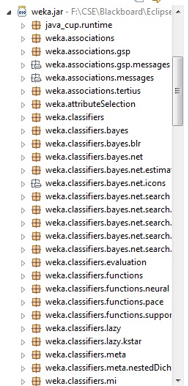
Inside the Library…
Different Classifiers
Filters
Functions
Others

Slide 7
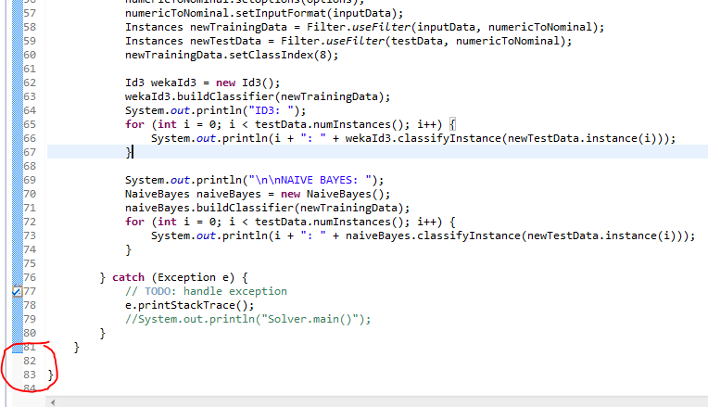
The result…

Slide 8

THANK YOU…

